Slide 1



Roxanne Guildford
PhD candidate in Archaeology
University of Edinburgh
Notes:
Opening remarks.
Discuss need for exploring quantitative methods in zooarchaeology to help find patterns in archaeological data.
Utilizing open data (aggregated reviews, digital repositories ie ADS, tDAR, Open Context) to look at sites comparatively across larger geographies and through time.
Need to treat archaeological data as an artefact: continue to address issues of preservation and recovery bias, and uncertainty.
Impossible to tackle all of the inherent problems with data → still important to try new methods.

Slide 2
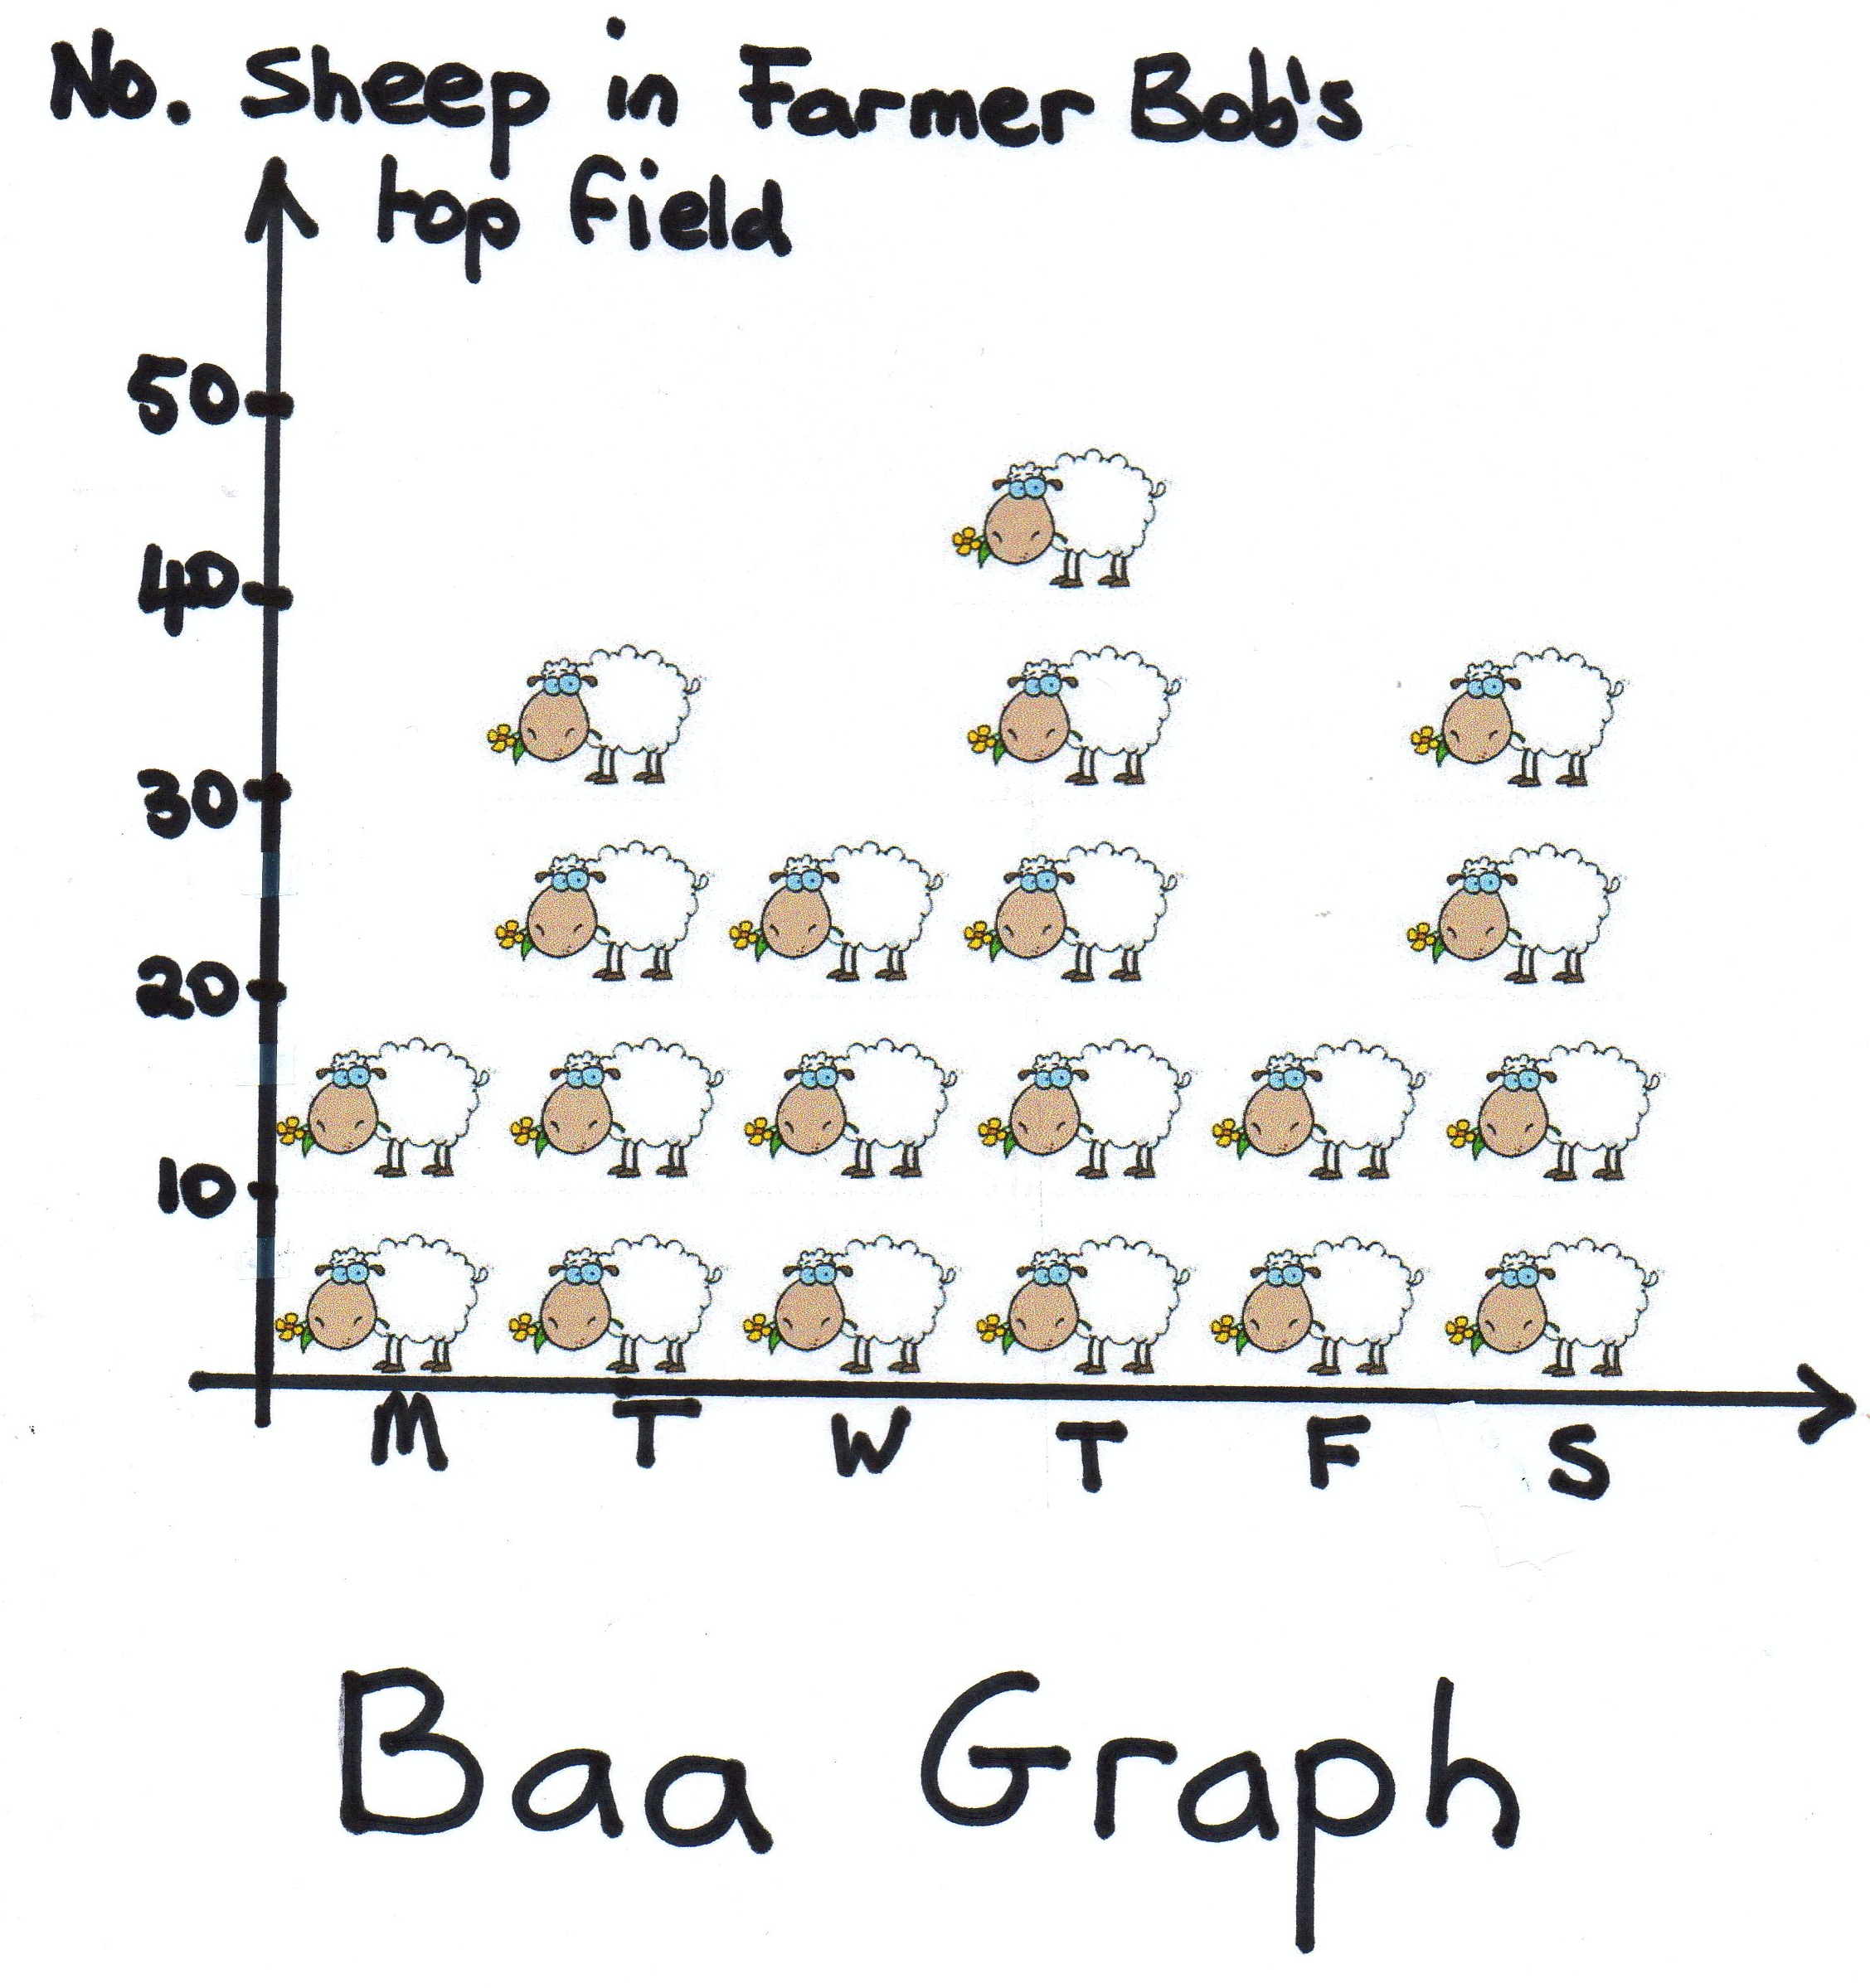
Why Count Medieval Sheep?
Cultural and economic shifts in land management
Change in pastoral husbandry strategies across time
Change in relationships between flock, farmer, and economic values
Notes:
We recognize today the necessity to treat archaeological data as an artefact: to do so, we must continue to address the ubiquitous issues of preservation and recovery bias, and uncertainty.
Of course, it is impossible to tackle all of the inherent problems with data analysis, particularly when dealing with complex assemblages.
So, in that case, why bother counting sheep?
Studying the relative ratio of sheep to other domesticated species in the archaeological record (aka taxonomic abundance) may show patterns in the data that help to explain:
Cultural and economic shifts in land management
Change in pastoral husbandry strategies across time
Change in relationships between flock, farmer, and economic values
Exploring quantitative methodology through case studies of British Medieval faunal assemblages open up some interesting research questions: how is the intensification of sheep husbandry relative to wool production in the UK represented in the archaeological assemblage? Are generalized interpretations accurate when looking at different scales of resolution? And how can we recognize the different variation in faunal assemblages national, regional, intra-site, inter-site levels of study?

Slide 3
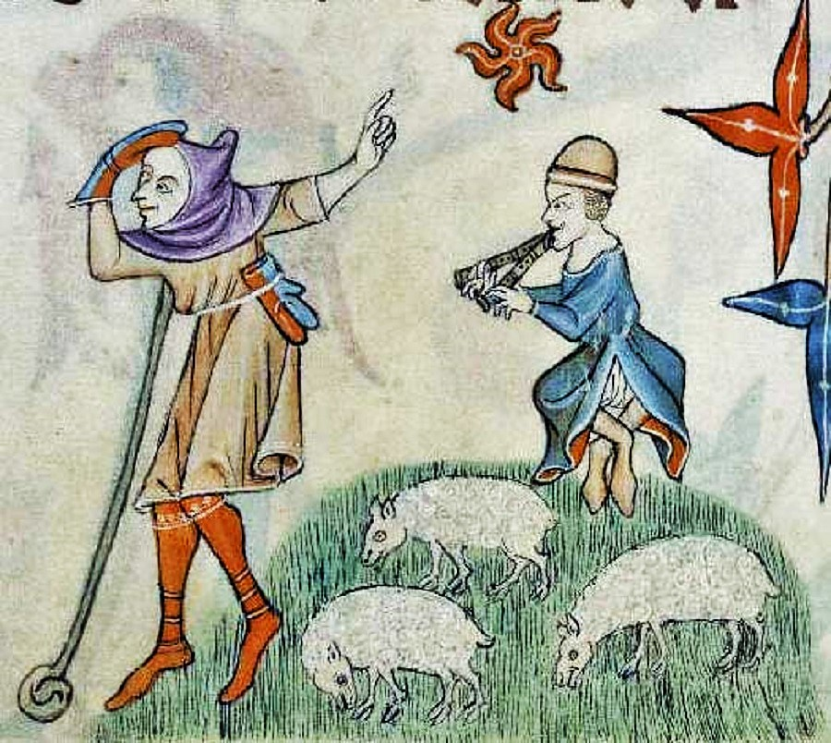
Distribution of Variation across the Landscape
Archaeological sites within modern geography
Abundance values related to elevation or environment
Effect of sample sizes on abundance values
Notes:
To address these questions, I am interested in 3 main aspects of how variation in site data is represented across a landscape or time period:
Zooarchaeological sites within modern geography
Abundance values related to elevation or environment
Effect of sample sizes on abundance values
It is the last two topics which I will be discussing further today.
For my PhD research, I am experimenting with the use of NISP and the relative abundance index for sheep (shown here as AIsheep values) as primary units of measurement for assemblage variation. Despite inherent biases in identified specimen counts, NISP remains the most widely used measurement in zooarchaeology today, and is the only quantitative unit that is reliably shared between any archaeological assemblage.

Slide 4
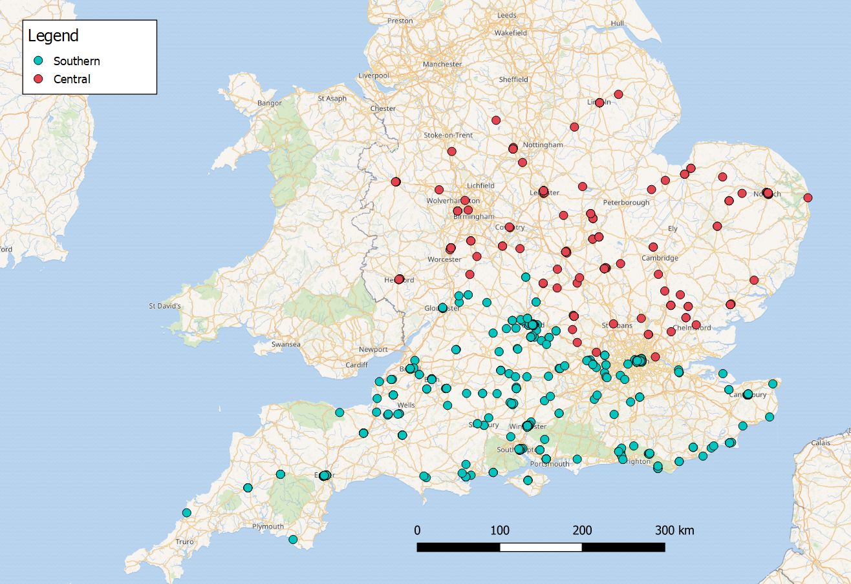
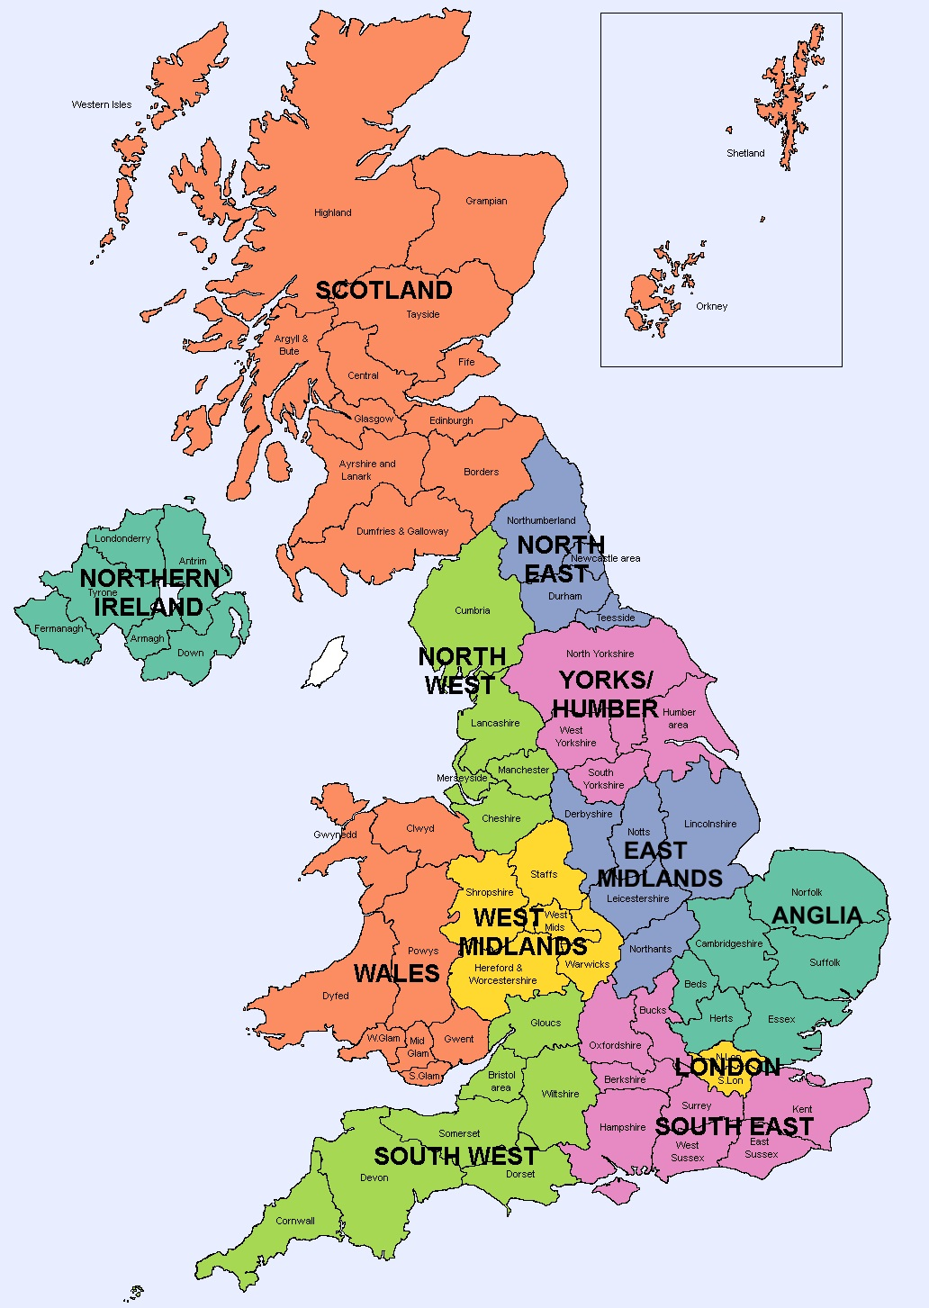
Notes:
A Review of Animal Bone Evidence from Central England by Umberto Albarella, Tessa Pirnie (2008)
A Review of Animal Bone Evidence from the Saxon to Post Medieval Periods in Southern Britain by Matilda Holmes (2018)
Comparative data from individual Anglo-Saxon and Medieval assemblages, funded by Historic England.
Obvious issue with data coverage: reviews only cover a small fraction of the entire UK; currently there are no reviews available for North England, Wales, or Scotland.
Other major issue with the data sets: published a decade apart, with very different parameters of study. Because both of these date sets show different characteristics of collection, it will be interesting to compare them to see how parameters affect faunal representation.

Slide 5
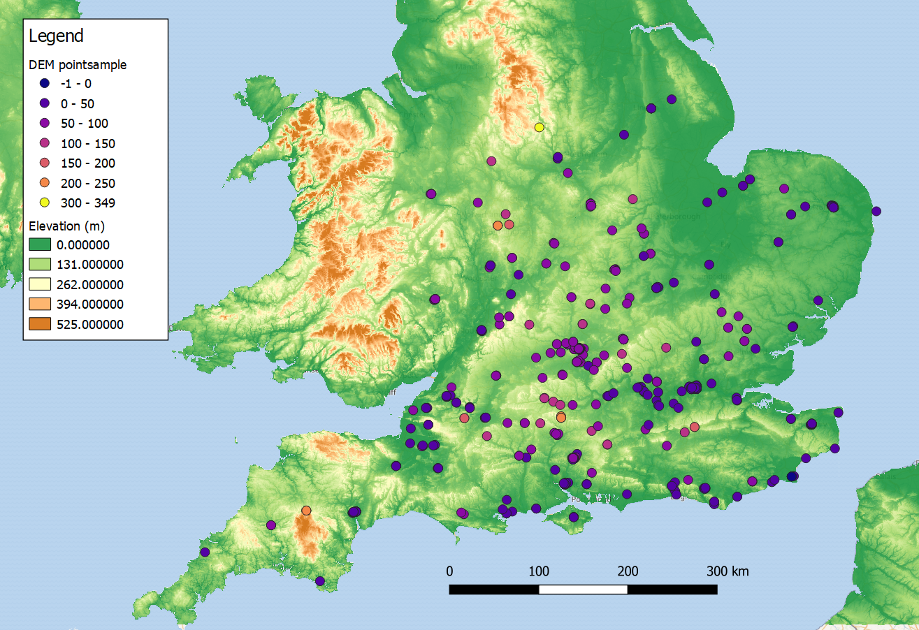
DEM
pointsample = meters
Notes:
How is variation of abundance values related to environmental or geographic factors, such as elevation?
For example, it is generally assumed that faunal assemblages will show an increase in sheep in areas of higher elevation (Grant, Simmons) in contrast to cattle at low elevations. Historic evidence and previous research in the 90s by John Power and Bruce Campbell in cluster analysis of Medieval farming systems in England also indicate a focus of pastoral farming through chalklands and East Anglia.
Shows the presence of sites in relation to elevation.
[General low elevations – compare to the next slide]

Slide 6
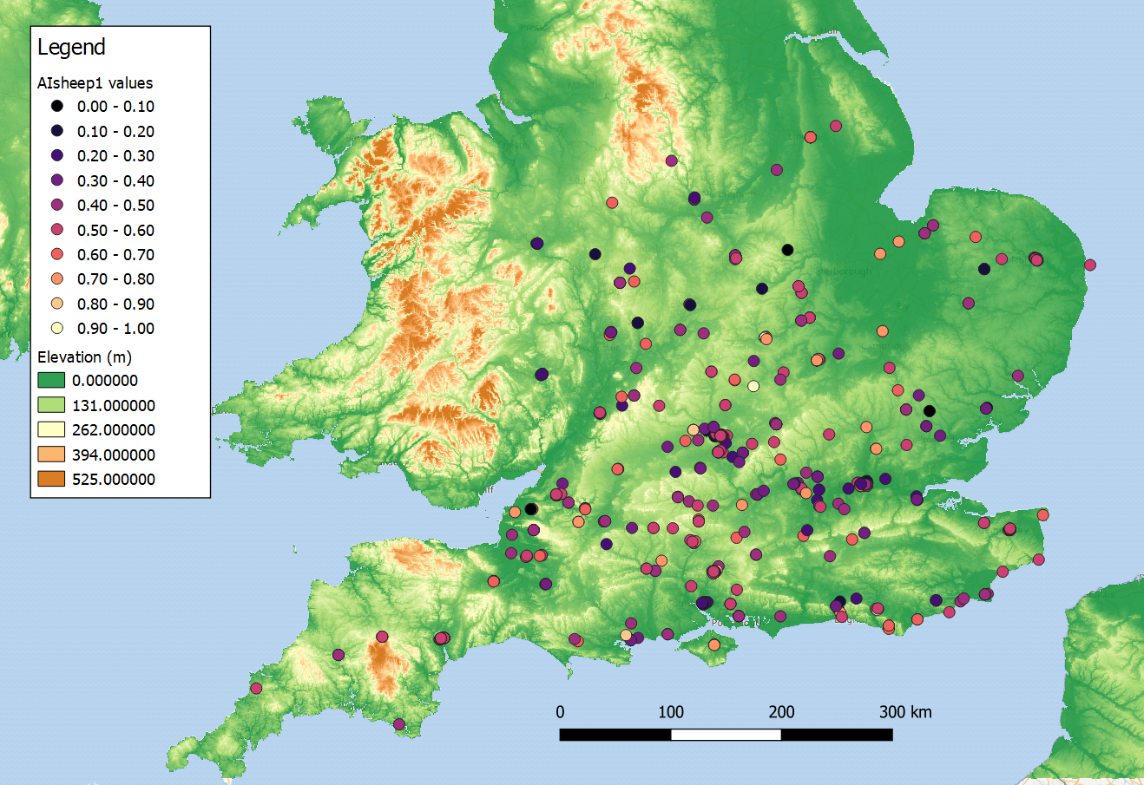
AIsheep1 =
Σsheep/ Σcattle + Σsheep
Notes:
Shows AIsheep values across the landscape.
Power and Campbell (1992) suggest highlighted areas would have had mostly pastoral (sheep) farms, wool production.
Chalklands is well-known for sheep, but the AI values still seem random.

Slide 7
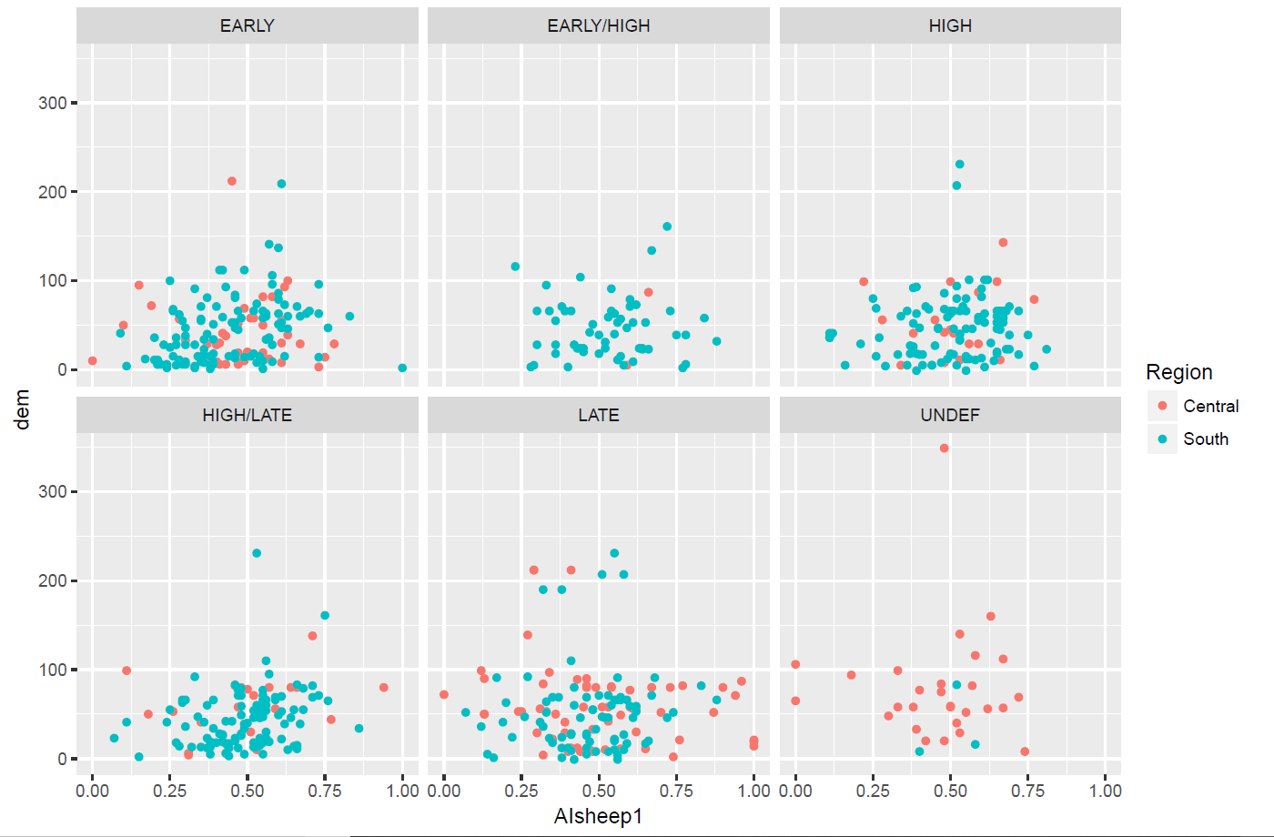
AIsheep1 =
Σsheep/ Σcattle + Σsheep
Notes:
Presence of possible outliers at opposite ends of the range
NISPsheep = 1.00
NISPcattle = 0.00
Differences in the spread of the data and the range are apparent
All sites except for 1 fall under 250m
Most sites fall under 100m (not very elevated)
Late Period stands out again as showing a more even distribution of values across the entire range, but Early-High and Undefined not useful for statistical analysis
Late Period stands out again as showing a more even distribution of data across the entire range
Early-High and Undefined not useful for statistical analysis

Slide 8
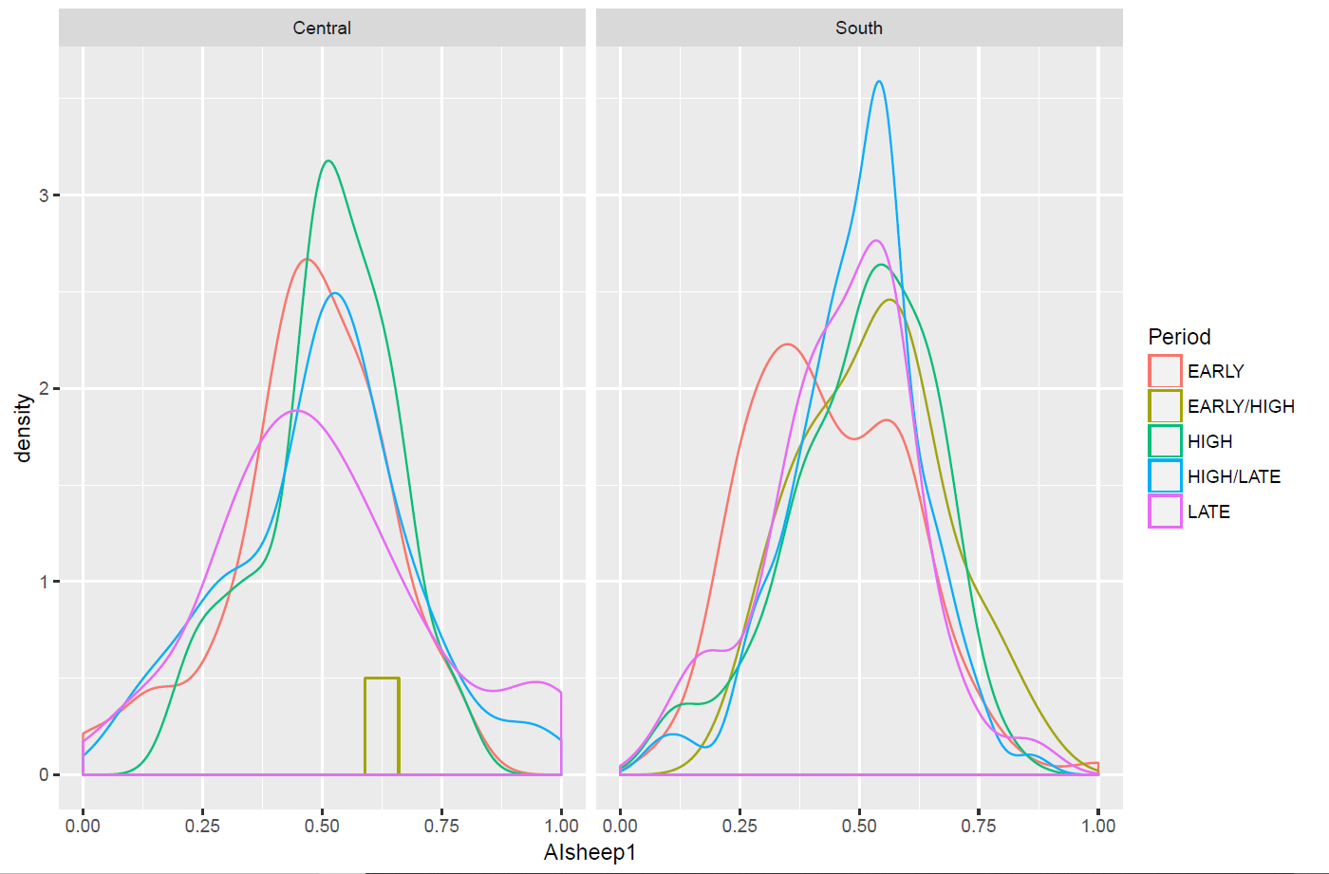
AIsheep1 =
Σsheep/ Σcattle + Σsheep
Notes:
While the density of entire data set appears somewhat normally distributed, if subset by time Period, Period, density curves indicate Early and Late chronologies do not show distributions → notes of interest in research
Most sites fall between 0.25 and 0.75 index, with the presence of possible outliers at the sheep dominance (1.00) and cattle dominance (0.00) range.
Central Region shifts slightly to the right of the mean; South shifts closer to the left. Which could indicate tendency towards higher abundance of sheep remains vs cattle, but before we can determine this, we need to consider the effects of sample size.

Slide 9
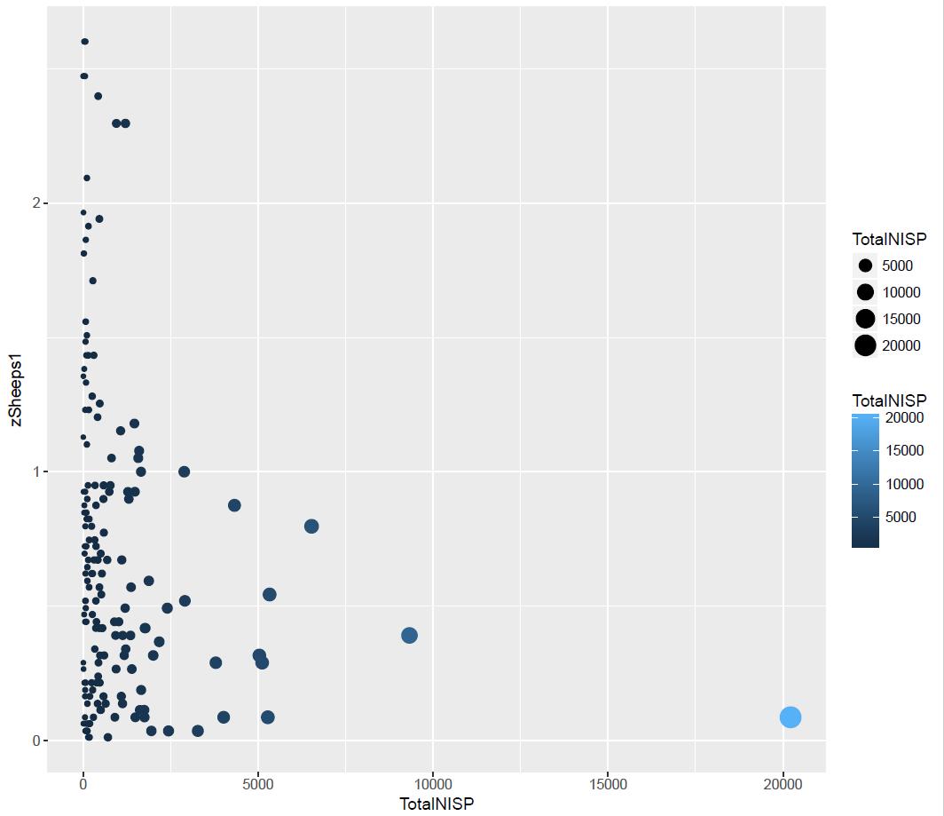
Effects of Sample Size
zSheep1 =
Z-score of AIsheep1 values
AIsheep1 values are directly affected by sample size
NISP is negatively correlated to the amount of variance in abundance index
Differences in NISP between assemblages
Notes:
Distribution of AIsheep1 values towards does not directly indicate species abundance. Variation in abundance scores found between assemblages could be from different reasons.
Discuss how AI score can also be affected by the sample size (NISP)
How to account for differences in assemblage NISP? → Need to attempt to quantify factors that might inflate or depress NISP count.
NISP is particularly sensitive to bone fragmentation.
One way of quantifying fragmentation of an assemblage through categorizing fragment types by species and element through a method called Fracture Freshness Index and Fracture History Profiles.

Slide 10
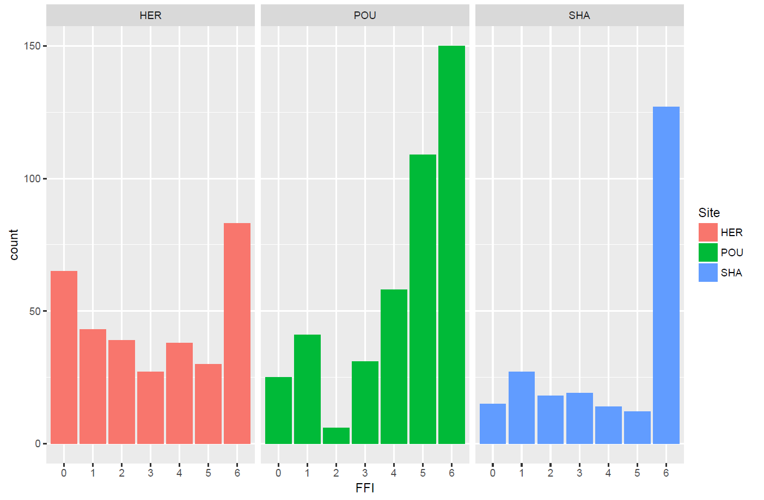
Fragmentation categories of 3 test sites
0-2 = Fresh break
3-5 = Dry break
6 = Mineralized break
Notes:
The following case study is a revision of FFI methodology developed by Alan Outram (2001, etc.) Previous studies of fracture index has been conducted on prehistoric assemblages (also Johnson et al publications); in my study, I have recorded the categorical variables for each fracture individually, without averaging the scores so I can apply hypothesis testing.
I have collected sample data from multiple sites (Hereford, Shapwick, and Poulton) in England that fall within the Roman – Medieval – Post Medieval period
Major difference = instead of taking the average of fragments on a bone, FFI is recorded up to 3 consecutive fragments per each bone and all fractures are presented in bar graph vs cumulative bar graph.
Can see that the fragmentation distribution between each site is quite different.
Another way to visualize this would be comparative representation: relative frequency distribution of each category within its own assemblage.

Slide 11
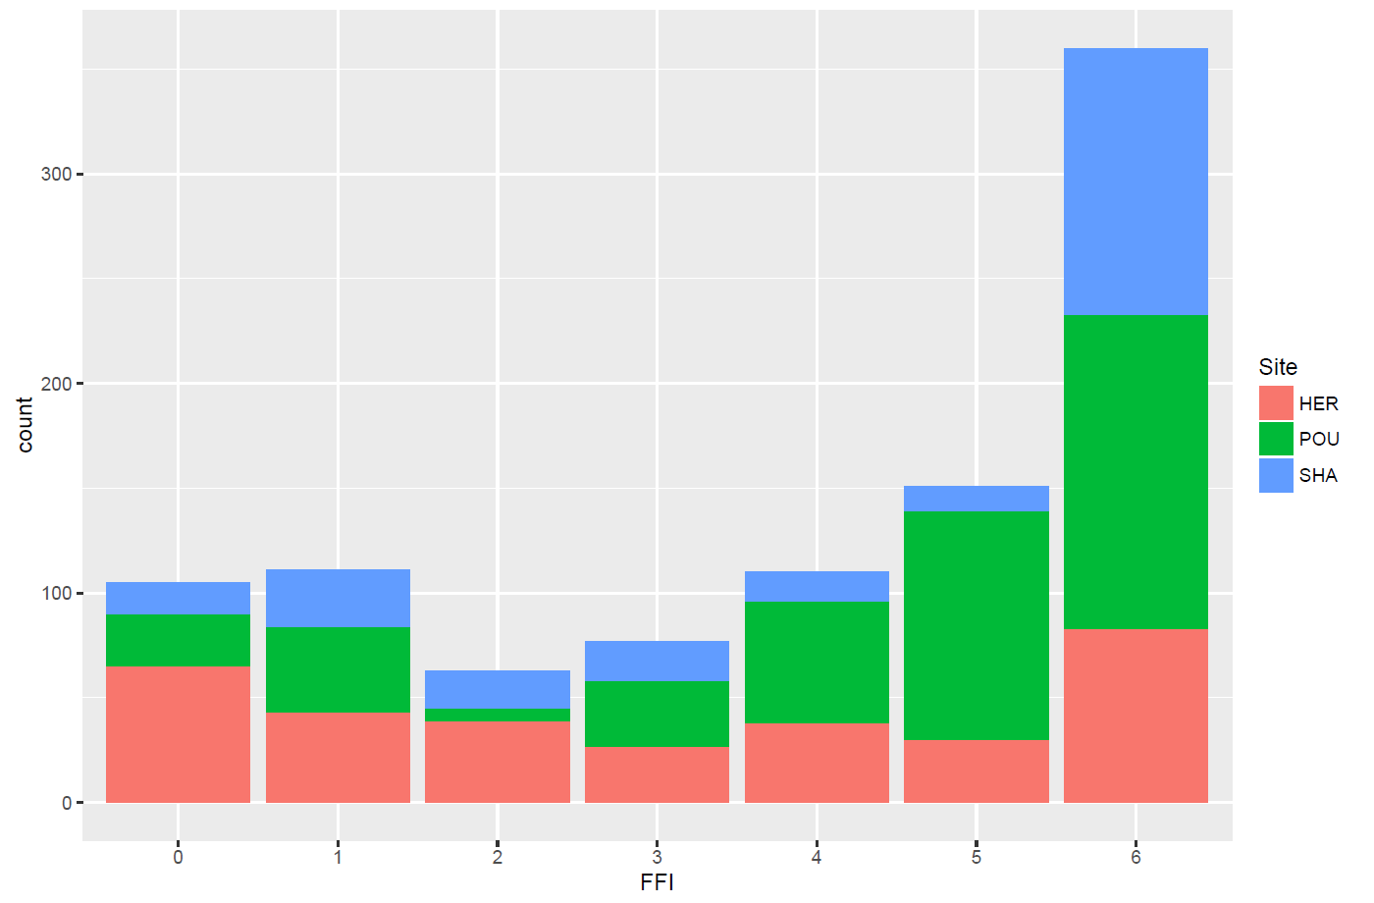
Fragmentation categories of 3 test sites
0-2 = Fresh break
3-5 = Dry break
6 = Mineralized break
Notes:
However, it is apparent that between all 3 sites, the FFI shows an overwhelming tendency towards category 6 = Mineralized breaks
Kruskal-Wallis rank sum test shows p-value = 6.314e-13 rejects the null hypothesis that the mean ranks of the sample sites are the same.
A posthoc test (pairwise Wilcox text) indicates that HER – POU, and SHA – HER are statistically different, but not SHA – POU.

Slide 12
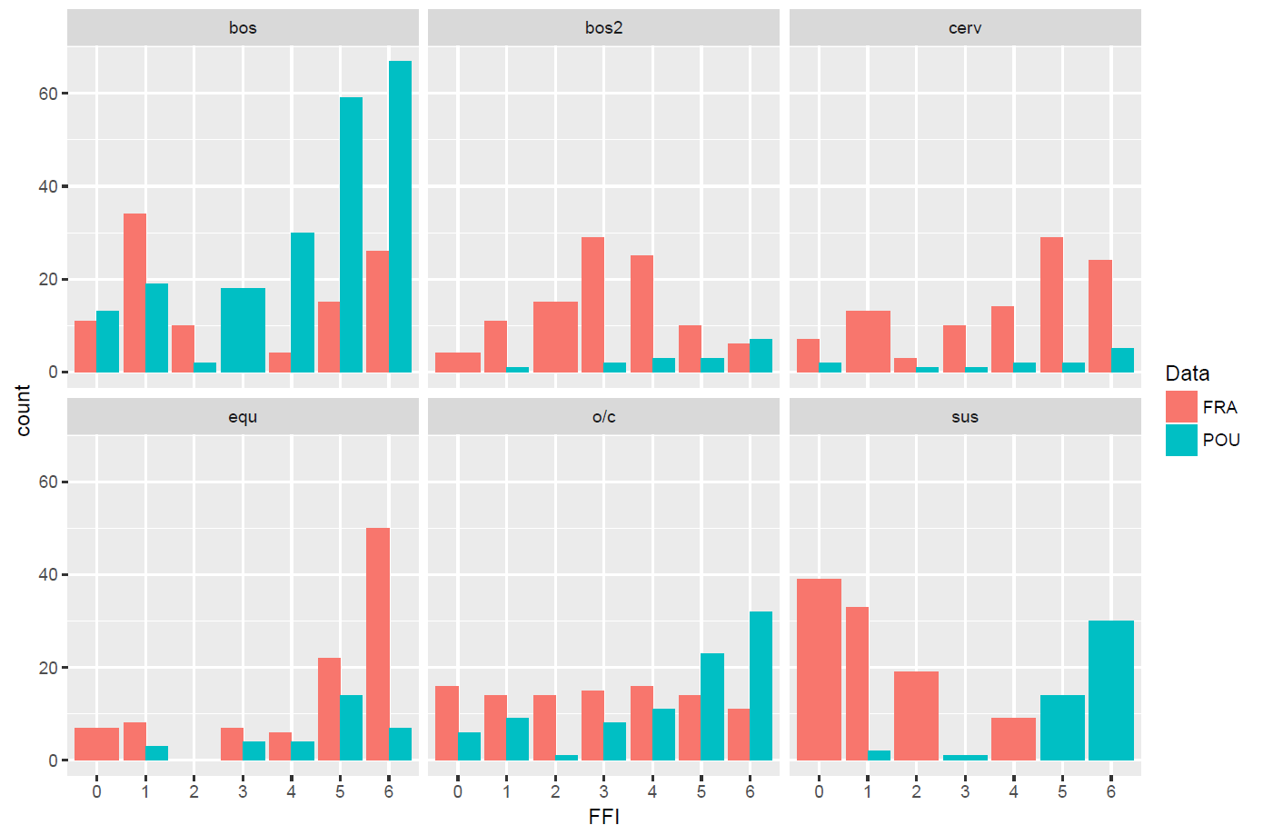
Do bar plots
Geom_bar(position=“dodge”) then color by data
Notes:
It is possibly to further experiment with the effects of fragmentation by creating dummy sets (FRA) to test the methodology against real data sets.
Underlying issue of testing for means: dummy data set shows that the means of samples can be the same or similar for vastly different distributions.
Dummy set will be very useful in further testing the effects of fragmentation on NISP counts leading to → effect of variance in AIsheep1

Slide 13
Discussion and Future Work
Data visualization of Medieval faunal assemblages demonstrates that variation in archaeological data may not be a direct proxy for human activity
Helps to pinpoint areas of research interest within large, aggregated data sets
Need to further explore patterns through judicial application of statistical testing and data modelling, applied with archaeological interpretation.
Continue spatial analysis to determine if any patterns emerge from:
Kernel density of site distribution
Proximity of sites to modern cities and other sites
Relationship of sites and hydrology (rivers, aquifers)
Exploration of FFI and Fracture History Profiles:
Chronology, species, location
Determine how to weight fragmentation to NISP
Conduct intra-site variation analysis with well-documented settlement assemblages.
Promote data collection for Scottish and Welsh sites.
Notes:
Data visualization of Medieval faunal assemblages demonstrates that variation in archaeological data may not be a direct proxy for human activity
Helps to pinpoint areas of research interest within large, aggregated data sets
Need to further explore patterns through judicial application of statistical testing and data modelling, applied with archaeological interpretation.
Continue spatial analysis to determine if any patterns emerge from:
Kernel density of site distribution
Proximity of sites to modern cities and other sites
Relationship of sites and hydrology (rivers, aquifers)
Exploration of FFI and Fracture History Profiles:
Chronology, species, location
Determine how to weight fragmentation to NISP
Conduct intra-site variation analysis with well-documented settlement assemblages.
Promote data collection for Scottish and Welsh sites.

Slide 14
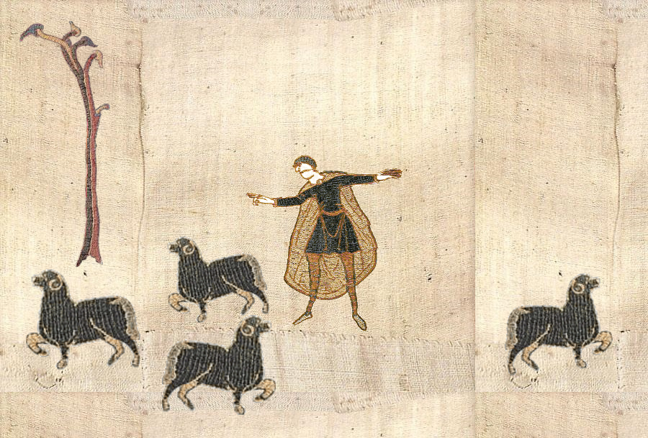
Thank You
roxanne.guildford@ed.ac.uk
https://github.com/rguildford

